Slide 1
Chare Arrays: Collection of Chares
© 2018 L. V. Kale at the University of Illinois Urbana

Slide 2
Chare Arrays
Indexed collections of chares
Every item in the collection has a unique index and proxy
Can be indexed like an array or by an arbitrary object
Can be sparse or dense
Elements may be dynamically inserted and deleted
Elements are distributed across the available processors
May be migrated to other nodes by the user or the runtime
For many scientific applications, collections of chares are a convenient abstraction

Slide 3
Declaring a Chare Array
.ci file:
array [1d] foo {
entry foo(); // constructor
// … entry methods …
}
array [2d] bar {
entry bar(); // constructor
// … entry methods …
}
chare
chare

Slide 4
Constructing a Chare Array
Constructed much like a regular chare, using ckNew
The size of each dimension is passed to the constructor at the end
The proxy represents the entire array, and may be indexed to obtain a proxy to an individual element in the array
void someMethod() {
CProxy_foo myFoo = CProxy_foo::ckNew(<params>, 10); // 1d, size 10
CProxy_bar myBar = CProxy_bar::ckNew(<params>, 5, 5); // 2d, size 5x5
}
myFoo[4].invokeEntry(…);
myBar(2,4).method3(…);

Slide 5
thisIndex
1d: thisIndex returns the index of the current chare array element
2d: thisIndex.x and thisIndex.y return the indices of the current chare array element
.ci file:
.cpp file:
array [1d] foo {
entry foo();
}
struct foo : public CBase_foo {
foo() { ckout << “array index: ” << thisIndex;
}
};

Slide 6
Chare Array: Hello Example
mainmodule arr {
mainchare Main {
entry Main(CkArgMsg∗);
}
array [1D] hello {
entry hello(int);
entry void printHello();
}
}

Slide 7
Chare Array: Hello Example
#include “arr.decl.h”
struct Main : CBase_Main {
Main(CkArgMsg∗ msg) {
int arraySize = atoi(msg->argv[1]);
CProxy_hello p = CProxy_hello::ckNew(arraySize, arraySize);
p[0].printHello();
}
};
struct hello : CBase_hello {
int arraySize;
hello(int n) : arraySize(n) { }
void printHello() {
CkPrintf(“PE[%d]: hello from p[%d]\n”, CkMyPe(), thisIndex);
if (thisIndex == arraySize – 1) CkExit();
else thisProxy[thisIndex + 1].printHello();
}
};
#include “arr.def.h”

Slide 8
Broadcast
A message to each object in a collection
The chare array proxy object is used to perform a broadcast
It looks like a function call to the proxy object
From a chare array element that is a member of the same array:
From any chare that has a proxy p to the chare array:
thisProxy.foo();
p.foo();

Slide 9
Reduction
Combines a set of values:
The operator must be commutative and associative
sum, max, …
Each object calls contribute in a reduction

Slide 10
Reduction: Example
#include “reduction.decl.h”
const int numElements = 49;
class Main : public CBase_Main {
public:
Main(CkArgMsg∗ msg) { CProxy_Elem::ckNew(thisProxy, numElements); }
void done(int value) { CkPrintf(“value: %d\n”, value); CkExit(); }
};
class Elem : public CBase_Elem {
public:
Elem(CProxy_Main mProxy) { int val = thisIndex; CkCallback cb(CkReductionTarget(Main, done), mProxy); contribute(sizeof(int), &val, CkReduction::sum_int, cb);
}
};
#include “reduction.def.h”
Output
value: 1176
Program finished.

Slide 11
Reduction Example: .ci file
mainmodule reduction {
mainchare Main {
entry Main(CkArgMsg∗ msg);
entry [reductiontarget] void done(int value);
};
array [1D] Elem {
entry Elem(CProxy_Main mProxy);
};
}
Entry Method Attribute

Slide 12
Reduction Example : callback to a chare-array element
#include “reduction.decl.h”
const int numElements = 49;
class Main : public CBase_Main {
public:
Main(CkArgMsg∗ msg) { CProxy_Elem::ckNew(thisProxy, numElements); }
};
class Elem : public CBase_Elem {
public:
Elem(CProxy_Main mProxy) { int val = thisIndex; CkCallback cb(CkReductionTarget(Elem, done), thisProxy[0]); contribute(sizeof(int), &val, CkReduction::sum_int, cb);
}
void done(int value) { CkPrintf(“value: %d\n”, value); CkExit(); }
};
#include “reduction.def.h”

Slide 13
Reduction Example : callback to a whole chare-array
#include “reduction.decl.h”
const int numElements = 49;
class Main : public CBase_Main {
public:
Main(CkArgMsg∗ msg) { CProxy_Elem::ckNew(thisProxy, numElements); }
};
class Elem : public CBase_Elem {
public:
Elem(CProxy_Main mProxy) { int val = thisIndex; CkCallback cb(CkReductionTarget(Elem, tellAll), thisProxy); contribute(sizeof(int), &val, CkReduction::sum_int, cb);
}
void tellAll(int value)
{ CkPrintf(“Elem[%d]: value: %d\n”, thisIndex value);… }
};
#include “reduction.def.h”
Broadcast callback

Slide 14
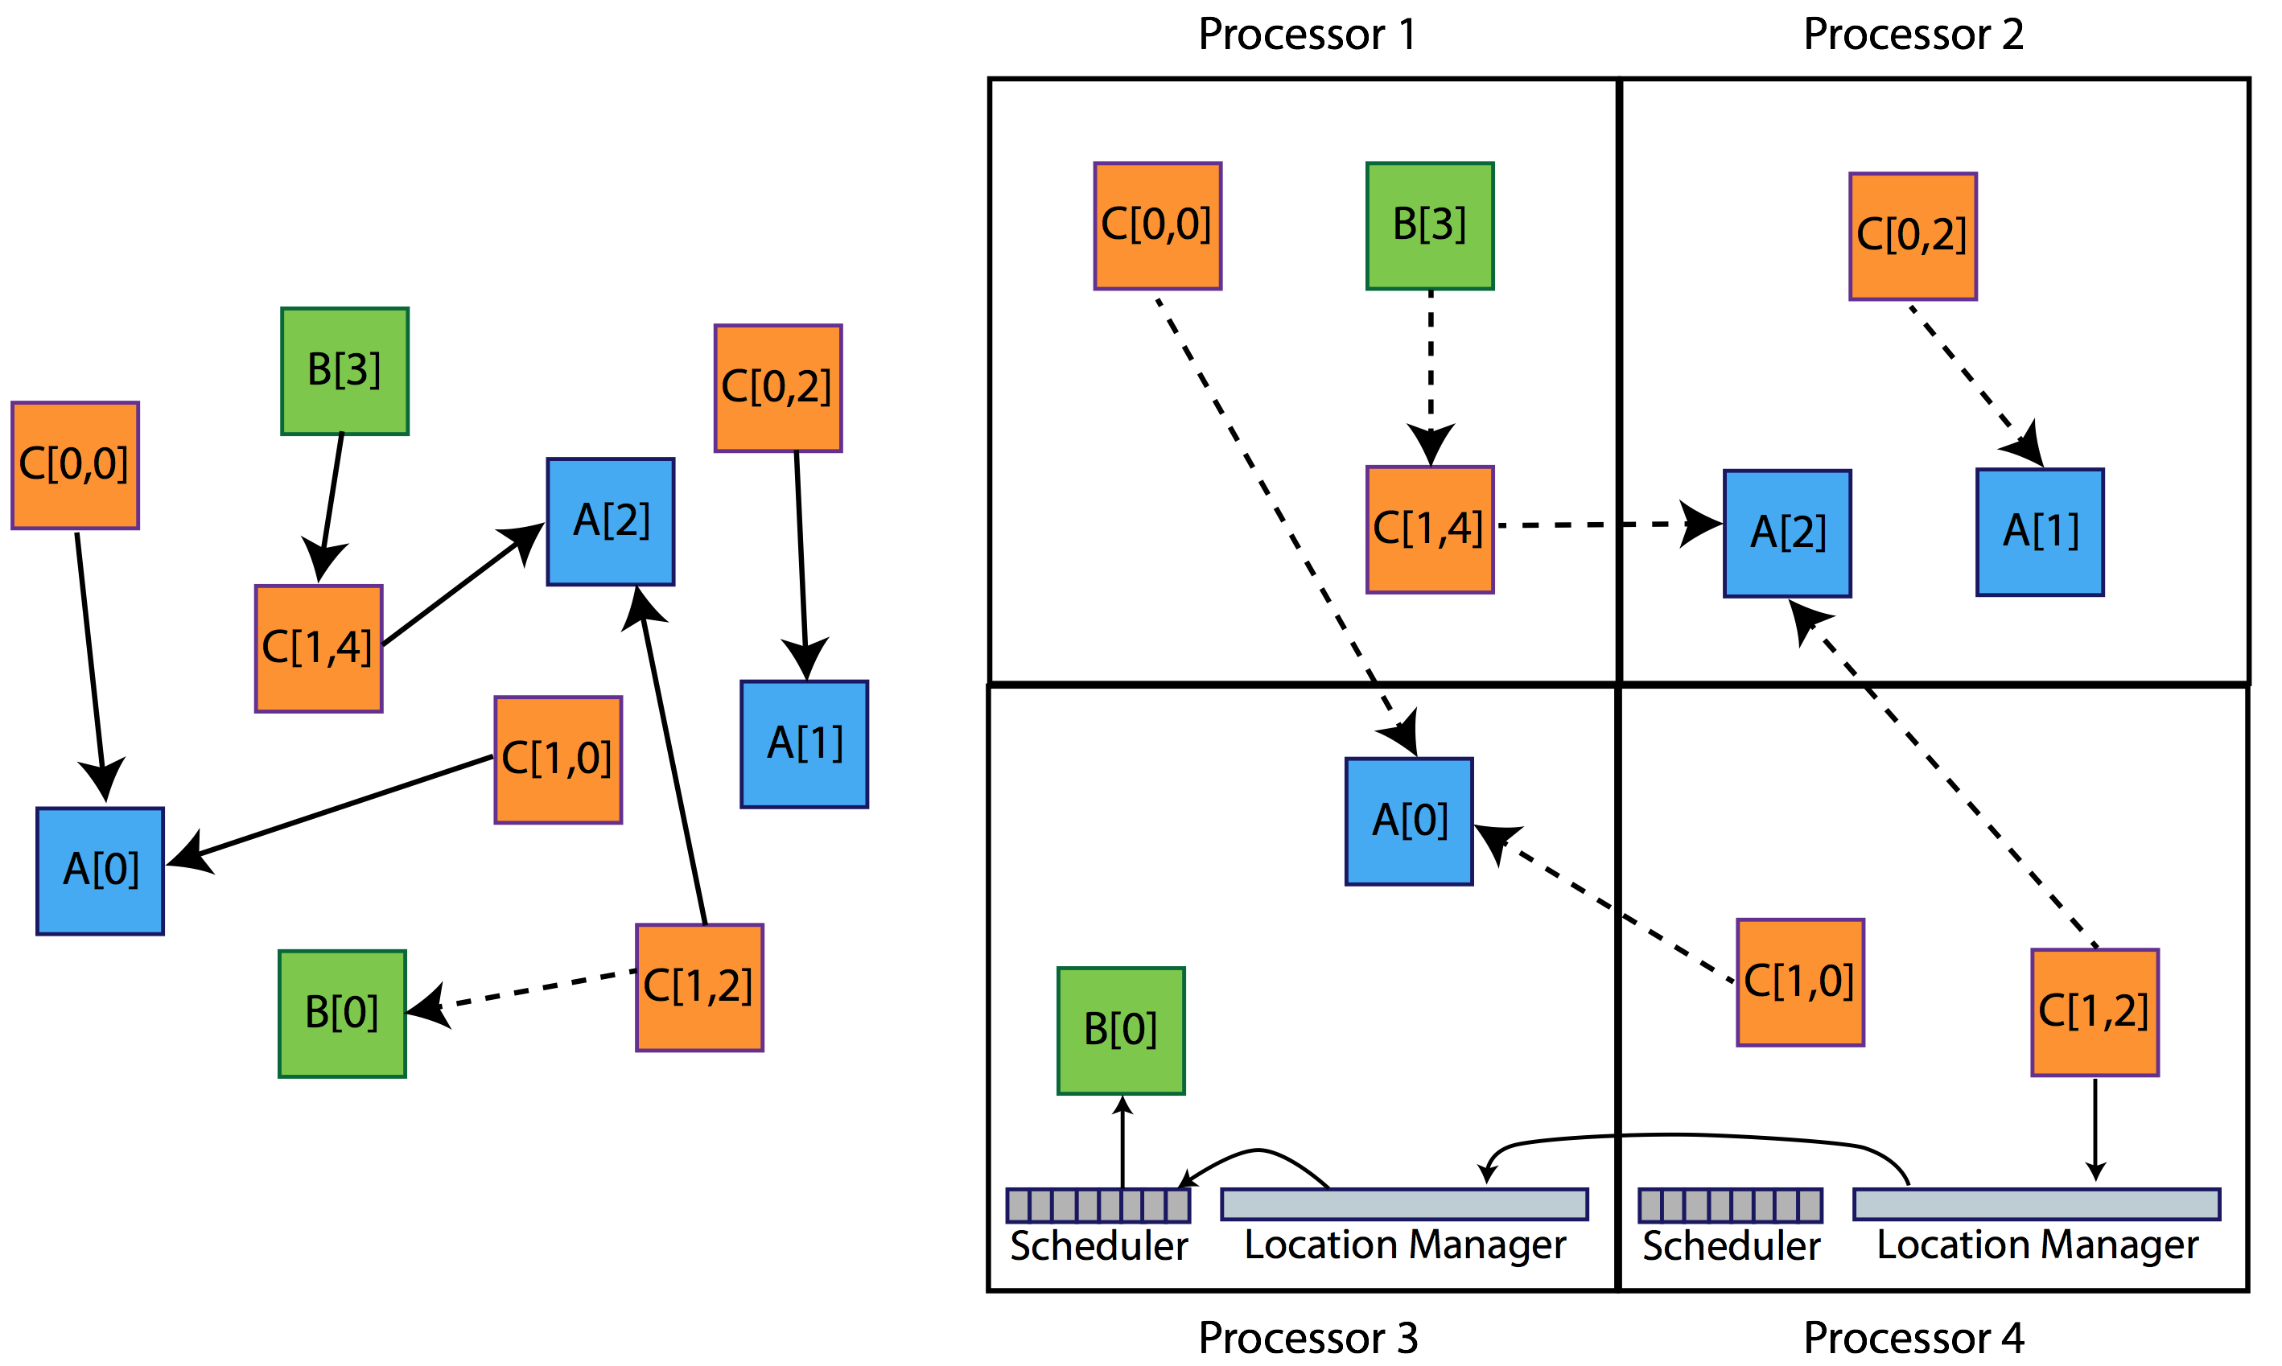
Chare Arrays view

